Slide 1
Sustaining activism through self care

Slide 2
Political warfare

Slide 3
Objectives
By the end of the session participants will have:
discussed the importance of self care in sustaining activism
shared strategies for coping with demands of being a WHRD
practised techniques to relax their bodies and minds

Slide 4
What does ‘sustaining activism’ mean?
“Being able to do the work you love, and still feeling full and happy in every part of your life. Feeling safe. Feeling connected. Feeling recognised, respected, valued – for you are, as much as for what you do”
(What’s the Point of Revolution if We Can’t Dance? Urgent Action Fund for Women’s Human Rights, Jane Barry with Jelena Dordevic)

Slide 5
Being well
What does well-being mean to you?
What would it take to for you to live in balance?

Slide 6
The river of my life http://www.youtube.com/watch?v=ojHqLW_AS4Y

Slide 7
Who is an activist?
Being a dissident or resisting:
objecting to the world and its stereotypes. Taking a political stand against a power that is conceived as unchangeable

Slide 8
Rebel
Being a rebel:
not just resisting and objecting, but acutally making a move. It means doing what is prohibited and being bold; breaking limits and taboos by taking risk and overcoming fear.

Slide 9
Subversive
Being subversive:
Challenging preconceived values, aspirations and desires.
(Self-care and Self-Defense Manual for Feminist Activists – Marina Bernal)

Slide 10
Challenging assumptions
What does being a good activist mean?
Notes:
Commitment, sacrifices for the cause, making this struggle the focus of one’s whole life?
Ideas – ‘the parable of the ‘good activist’ with a moral at the end of the story
Do they know an activist they admire who has a work/life balance? What could you learn from them? The self evaluation wheel exercise – divide into stresses (shade in how much they stress you out – think about reducing it..)

Slide 11
What’s bad about being ‘good’?
Promotes practices that are difficult to sustain
Are incongruent with the self-care and self-protection of activists themselves
Sacrifice aspects of personal life
Concern that personal issues shouldn’t interfere with work or that are seen as selfish

Slide 12
Why self-care?
“When there is so much demand, so much more to do, what right do you have to consider your own needs? You just go on stretching, working more hours at night, doing without. You keep pulling it off – off your own back.”
(What’s the Point of Revolution if We Can’t Dance? Urgent Action Fund for Women’s Human Rights, Jane Barry with Jelena Dordevic)

Slide 13
But….
But this will eventually threaten your ability to work safely and sustainably.

Slide 14
Burn out
“My years working as a HRD.. Were eye opening. Never before had I been so inspired… or so completely exhausted or stressed out. In my fourth year I knew I was burnt. I no longer looked forward to going to work in the mornings. I looked to my mentors to see how they had managed to stay in the game for more than 20 years and clearly saw the sacrifices they had made in their own lives, and the gambles they had made with their health”.
(What’s the Point of Revolution if We Can’t Dance? Urgent Action Fund for Women’s Human Rights, Jane Barry with Jelena Dordevic)

Slide 15
Symptoms of burnout include:
Emotional, mental, somatic exhaustion
Feelings of helplessness and hopelessness
Feeling of emptiness
Somatic symptoms:
Headache
Weakness
Overstretching
Pain in the shoulders
Gastric pain
Weight gain
Decrease in immunity towards infections
Sleep disorders
Emotional symptoms: depression, ‘my soul died’
Mental symptoms: negative attitude, rigidity and distance in human relationships, cynicism instead of empathy
(EHAHRDP ‘Defending Human Rights – A resource book for human rights defenders)

Slide 16
10 habits of effective stress managers

Slide 17
How many of these describe you?
You know how to relax.
You eat right and exercise often.
You get enough sleep.
You don’t worry about the unimportant stuff.
You don’t get angry often.
You are organised.
You manage your time efficiently.
You have and make use of a strong social support system.
You live according to your values.
You have a good sense of humour.

Slide 18
Tools for coping

Slide 19
What keeps you going, what sustains you?
The right to rest
Keeping safe
Recognition
Personal relationships

Slide 20
Strategies used by HRDs
Pleasure
Spirituality
Friendship/support groups
Crying it out
Giving comfort whilst needing comfort
Saying no to working weekends
Having a laugh
Writing
therapy
Organisational strategies for staff well-being (flexible working hours, sabbatcials, pension, budget, social secretary
Dancing, partying
Talking – making the private public

Slide 21
Prevention and Recovery
STOP DENYING
Listen to your body. Begin to feely admit the stresses and pressures which have manifested physically, mentally or emotionally.

Slide 22
Getting it?

Slide 23
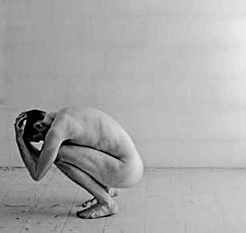
Avoid Isolation
Don’t do everything alone. Develop or renew intimacies with friends and loved ones. Closeness not only brings new insights, but also is anathema to agitation and depression.

Slide 24
Change your circumstances
If your job, your relationship, a situation, or a person is dragging you under, try to alter your circumstances, or if necessary, leave.

Slide 25
Diminish intensity in your life
Pinpoint those areas or aspects which summon up the most concentrated intensity and work toward alleviating that pressure.

Slide 26
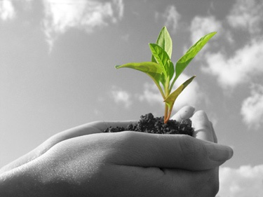
Stop over-nurturing
If you routinely take on other people’s problems and responsibilities, learn to gracefully disengage. Try to get some nurturing yourself.

Slide 27
Learn to say ‘no’
You’ll help diminish intensity by speaking up for yourself. This means refusing additional requests or demands on your time and emotions.

Slide 28
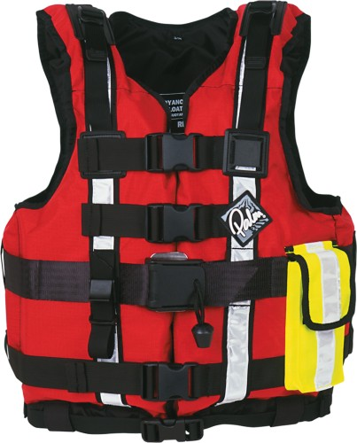
Begin to back off and detach
Learn to delegate, not only at work, but also at home and will friends. In this case, detachment means rescuing yourself from yourself.

Slide 29
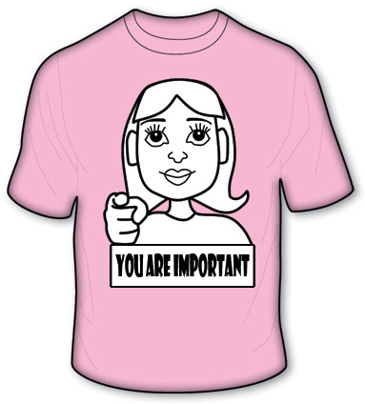
Re-assess your values
Try to distinguish meaningful values from the temporary and fleeting, the essential from the non-essential. You will conserve energy and time, and begin to feel more centred.

Slide 30
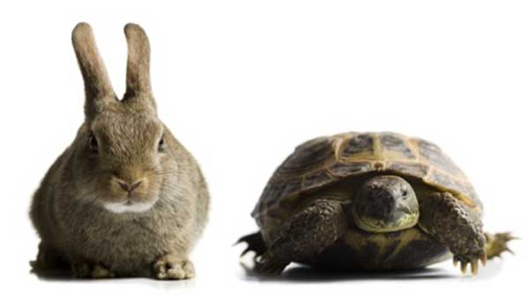
Learn to pace yourself
Try to take life in moderation. You only have so much energy available. Ascertain what is wanted and needed in your life, then begin to balance work with love, pleasure, and
relaxation.

Slide 31
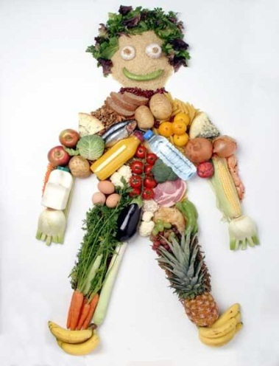
Take care of your body
Don’t skip meals, abuse yourself with rigid diets, disregard your need for sleep, or break the doctor appointments. Get some exercise and take care of yourself nutritionally.

Slide 32
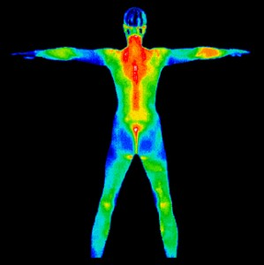
1 minute body scan

Slide 33
Listen to your body
Is your brow furrowed?
Are your eyebrows knitted?
Is your jaw clenched?
Are your lips pursed?
Are your shoulders hunched?
Are your arms tense?
Are your thigh and calf muscles tense?
Are your toes curled?
Do you notice any discomfort anywhere else in your body?

Slide 34
Diminish worry and anxiety
Try to keep superstitious worrying to a minimum – it changes nothing. You’ll have a better grip on yourself if you spend less time worrying and more time taking care of your real needs.

Slide 35
Fingerholds to manage emotions
Anger, resentment, rage
Worry, anxiety, preoccupation
Fear, panic
Lack of self esteem
Tears, grief, emotional pain

Slide 36
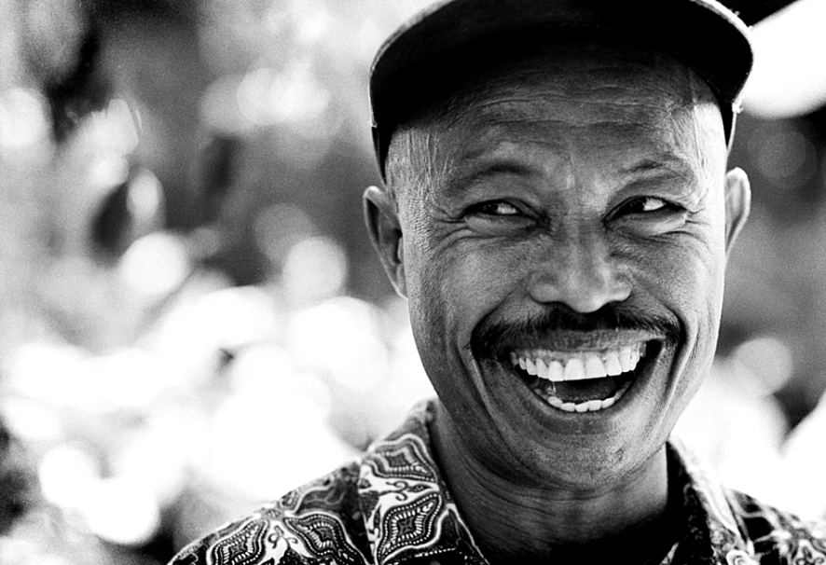
Keep your sense of humour
Begin to bring joy and happy moments into your life. Very few people suffer burnout when they’re having fun.

Slide 37
What’s next?
Dedicate real time in your organisations to talk about well-being together and the ways forward
Think about well-being as a human rights principle, integral to human dignity
Develop a stress reduction plan
Make an appointment with yourself (!)
Practise!
Try something new
Set boundaries
Work/life balance – do it!

Slide 38
And finally …
“Caring for others is powerful – but the culture of self-sacrifice is not sustainable. I am learning now how to set my boundaries. How to make a balance between me and others. I am important to myself as well. I should not be unjust to myself. When we care for ourselves then we also care for others.”
(What’s the Point of Revolution if We Can’t Dance? Urgent Action Fund for Women’s Human Rights, Jane Barry with Jelena Dordevic)

Slide 39
Let’s reflect
What does well-being mean to you?
What would it take to for you to live in balance?
What are your key learning points from this session?
What are you going to do more/less of?
What would you like to find out more about? How will you do this?

